Slide 1

The Infrastructure Investment and Jobs Act (IIJA)
Bipartisan Infrastructure Bill

Slide 2
Joe McKinney, NADO
Jmckinney@nado.org
Mirielle Burgoyne, NADO
mburgoyne@nado.org
Hal Hiemstra, summit strategies
Halh@summitstrategies.us

Slide 3
ABOUT NADO
  The National Association of Development Organizations (NADO) advocates for the nation’s network of hundreds of Regional Development Organizations (RDOs) across the country, and for the economic and community development programs they help implement
  www.nado.org
  Interested in becoming a NADO member?
  Please contact Brittany Salazar at bsalazar@nado.org or Krystal De Leon at kdeleon@nado.org

Slide 4
IIJA Overview
  The Infrastructure Investment and Jobs Act (IIJA) was signed into law on Monday November 15, 2021
  The IIJA is a $1.2 trillion bipartisan infrastructure bill which reauthorizes surface transportation programs
  Authorizes $550 billion in new spending – for all modes of transportation

Slide 5
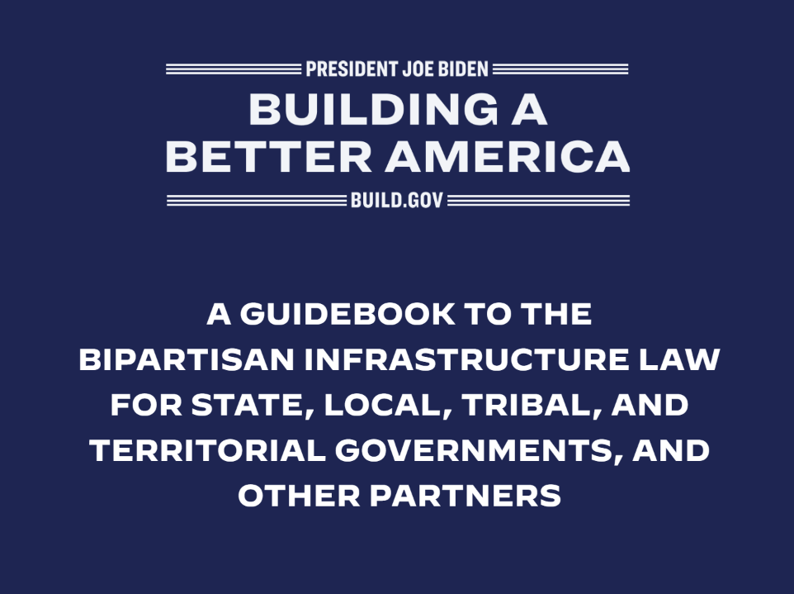
Helpful new overview released Jan 31, 2022:
White House IIJA Guidebook
IIJA and BIL - White House Guidebook

Slide 6
What TypeS of Infrastructure does the IIJA fund?
Takes broad view of infrastructure:
- Transportation
- Electric vehicles and charging infrastructure
- Energy
- Water
- Broadband
- Buildings
- Research and Development
- Manufacturing
New Funding
Transportation:
Roads and Bridges -$110B
Railroads - $ 66B
Public Transit - $ 39B
Airports - $ 25B
Ports - $ 15B
Road Safety - $ 11B
Reconnecting Communities -$ 1B
Utilities:
Power Infrastructure - $ 65B
Broadband - $ 65B
Water Infrastructure - $ 55B
Resilience - $ 47B
Pollution remediation - $ 21B
Western Water Infrastructure -$8B

Slide 7
How much Funding is available for Transportation Programs?
$567.5 billion for Departments of Transportation (DOT) programs
  $293.4 billion in baseline spending (i.e. funding re-authorized from prior transportation laws)
  $274.1 billion is new spending for transportation
    Funding will be distributed by:
      formula
      competitive grants
      low-cost loans
    State Departments of Transportation, transit agencies and airports will receive formula funds directly.
      Some formula funds include specific set-asides requirements for local governments, and certain activities including planning activities and bridges
    In many instances, MPOs and RTPOs are specifically identified as being eligible to apply for competitive grants.

Slide 8
IIJA includes Significant Increase In Planning (PL) Funds, emphasizes CONSULTATION, and creates new opportunities for grant funding
Planning funds are a set-aside of the Surface Transportation Block Grant Program.
  Because STBG grows to $72 billion, funding for Metropolitan Planning activities (PL- funds) grows by more than 30% to $2.28 billion over the life of the IIJA.
  State Planning and Research (SPR) also increases significantly in tandem with the increase in STBG, which some RTPOs use as planning funds
Various requirements for consultation with Regional Transportation Planning Organizations are emphasized in the IIJA, and RTPOs are specifically identified as eligible for grant funding – for example,
  The IIJA requires that states shall consult with RTPOs before obligating funding in areas with a population less than 50,000 if a regional transportation planning organization represents that geographic area.
  Under the new $6.41 billion Carbon Reduction Program, states are required to consult with any RTPO or MPO that represents the rural area prior to determining which activities should be carried out under a specific carbon reduction project. States must also suballocate 65 percent of funds apportioned to this program on a per-capita basis to counties and other local governments in the same way STBG funds are distributed.

Slide 9
Requirements for consultation or New RTPO eligibility
Under the new Transportation Access Pilot Program which is intended to develop or procure accessibility data that will improve transportation planning and measure access by mode to important destinations, regional transportation planning organizations are specifically identified as eligible participants in the pilot program.
Under the new Rural Surface Transportation Grant Program ( $2 billion over five years) “rural areas” are defined as any area outside of an urbanized area with a population over 200,000. The Secretary can make grants (generally over $25 million) to expand the surface transportation infrastructure in rural areas. Eligible entities specifically include regional transportation planning organizations.
Amtrak – the IIJA includes significant new funding for Amtrak, and requires that the Secretary conduct a study to evaluate the restoration of daily intercity rail passenger service along discontinued Amtrak’s long-distance routes, and requires that regional transportation planning organizations be consulted in the process.

Slide 10
Department of Transportation Competitive Grants
Over $150 billion for competitive grants over the life of IIJA
Most grant programs require matching funds
Program Name | Amount (over 5 years) | Description
Rebuilding American Infrastructure and Equity (“RAISE”) grants. This program was previously called BUILD and TIGER | $7.5 billion in guaranteed approps + $7.5 authorized for addition appropriations | Projects that will have a significant economic impact and improve transportation infrastructure, including road, bridge, public transit, passenger or freight rail, port, surface transportation components of airport projects and projects to replace culverts or prevent stormwater runoff. Max grant is $25 million.
Nationally Significant Freight and Highway Projects (known as “INFRA”). | $14 billion ($8 billion in guaranteed approps + $6 billion in authorized Trust Fund dollars) | Highway and rail projects of regional and national significance. Projects must equal or exceed the lesser of $100 million or 30 percent of the amount apportioned to the state. At least 10 percent of the funds are for small grants between $5 million and $25 million. Projects must be reasonably expected to begin construction within 18 months after the date of obligation. The federal share may not exceed 60 percent.

Slide 11
Department of Transportation Competitive Grants
Program Name | Amount | Description
Strengthening Mobility and Revolutionizing Transportation (“SMART”) Grants | $500 million | New program will fund smart city projects that improve transportation efficiency and safety, including coordinated automation, connected vehicles, intelligent sensor-based infrastructure, systems integration, commerce delivery and logistics, leveraging innovative aviation technology such as unmanned aircraft systems, smart grids and smart technology traffic signals. Encourages private sector innovation and partnerships.
Reconnecting Communities | $1 billion ($250 million for planning and $750 million for construction) | New program funds projects that remove, retrofit or mitigate previously constructed barriers to mobility, access or economic development to restore community connectivity.
Projects of National Significance | $5 billion | New program funds large-scale projects that generate economic, mobility or safety benefits and are cost-effective. Funds highway, bridge, freight intermodal, railway-highway grade separation and elimination, intercity passenger rail and public transportation projects. Project must cost at least $500 million. Secretary may enter into multiyear grant agreements. (note, may relieve some pressure on INFRA grants making them more assessable to mid-sized projects)

Slide 12
Department of Transportation Competitive Grants
Program Name | Amount (over 5 years) | Description
Promoting Resilient Operations for Transformative, Efficient and Cost- Saving Transportation (“PROTECT”) Grants | $1.4 billion | New program funds projects that improve resiliency and address vulnerabilities to current and future weather events, including sea level rise. Funds may be used for highways, transit and port infrastructure.
Rural Transportation Grant Program | $2 billion (ramps up from $300M in year one to $500M in year 5) | New Program - Eligible entities (include RTPOs) can apply directly to USDOT to carry out a wide variety of highway and bridge projects . Eligible entities can bundle projects. 80% fed share.
Safe Streets for All Grants | $5 billion | New program funds projects to implement "vision zero" plans and other improvements to reduce crashes and fatalities and protect pedestrians and bicyclists.
Healthy Streets Grants | $500 million | New program funds projects to install cool pavements and porous pavements and to expand tree cover.
Congestion Relief Program | $250 million | New program funds projects in cities with populations of more than 1 million that reduce congestion, including high-occupancy vehicle (HOV) lanes, toll lanes, cordon pricing, parking pricing and congestion pricing and implementation of mobility services and incentive programs that encourage nonhighway travel and travel during nonpeak times.

Slide 13
Department of Transportation Competitive Grants
Program Name | Amount (over 5 years) | Description
Port Infrastructure Development Program | $2.25 billion | Competitive grant program that funds infrastructure projects at public ports.
Bridge Discretionary Grants (part of new $40 billion Bridge Investment Program – most of which is distributed by formula) | $12.5 billion | New program to rehabilitate and replace bridges. Min grant size is $50M for large projects, $2.5M for small projects, Requires Sec. to prioritize projects that have applied for but not yet received fed grants.
Consolidated Rail Infrastructure and Safety Improvements (CRISI) | $5 billion | Funds projects that improve safety, efficiency and reliability of intercity passenger and freight rail.
Railroad Grade Crossing Elimination Program | $2.5 billion | New program that funds projects to eliminate at-grade railroad crossings, add gates or signals, relocate tracks and install bridges. Sets aside funding for planning and to carry out highway-rail grade crossing safety information and education programs.
Airport Terminal Program | $5 billion | New grant program for airport terminal development projects. Includes multimodal projects and projects for on-airport rail access. Secretary must give consideration to projects that increase capacity and passenger access, replace aging infrastructure, expand access for people with disabilities, improve airport access to historically disadvantaged persons and improve energy efficiency.

Slide 14
Transportation Alternatives and other Opportunities for new Funding
Program Name | Amount (over 5 years) | Description
Transportation Alternatives Program (TAP) | $7.2 billion | TAP increased to 10 percent of the entire STBG Program. The percentage states are required to sub-allocate to local governments is based on population and increases from 50 to 59 percent; states can choose to sub-allocate up to 100 percent of its TAP funds. TAP funds can carry out a wide variety of eligible projects including planning, design and construction of trails, bike-ped projects, environmental mitigation activities to address stormwater management, etc.
Off-system Bridge Set-Aside (within the STBG program) | $5.18 billion | Off system bridges make up nearly half of the nation’s bridges. Because they at not located on the Nat. Hwy System, they often suffer from underinvestment. A new “off-system” set aside increases from 15 to 20 percent of a state’s FY2009 share of the no-longer-existent Highway Bridge Program, resulting in increased funding that must be set aside for off-system bridges in every state.
Active Transportation Infrastructure Investment Program | $2.5 billion (subject to annual approps) | Creates a new program for active transportation grants that fund local and regional trail/bike/ped networks and transportation “spines” linking trail systems between communities.

Slide 15
Water Programs
$55 billion for Environmental Protection Agency (EPA) programs, including:
    $30 billion for State Drinking Water Revolving Loan Program
    $5 billion for State Clean Water Revolving Loan Program
    $1.5 billion for Brownfield Grants
    $1.4 billion for Sewer Overflow and Stormwater Municipal Grants (subject to annual appropriations)
$1billion for Federal Emergency Management Agency (FEMA) state resiliency grant program (BRIC)
$83 billion for Bureau of Reclamation programs
$9.55 billion for U.S. Army Corps of Engineers programs for authorized projects
    Note: Congress is expected to enact a new Water Resources Development Act in 2022 and this is the legislation where Army Corps of Engineers projects are authorized.

Slide 16
Broadband Funding: attempting to address the digital divide
Authorizes $62.4 billion in funding for Six grant programs, each aimed at address specific elements of the digital divide.
  $42.45 billion for broadband grants to states, DC, Puerto Rico, and other U.S. territories to be administered by the National Telecommunications and Information Administration (NTIA). Funds will be distributed in two phases:
        Phase One: NTIA will allocate grants to states based on maps identifying “underserved areas”.
        Phase Two: States are to competitively award the money distributed by NTIA to “subgrantees” to carry out broadband deployment activities within the state’s jurisdiction.
  $14.2 billion for Broadband Affordability – Extends and modifies Emergency Broadband Benefit (EBB) enacted as part of CARES Act to subsidize broadband service for eligible households.
  $2 B for Tribal Broadband Connectivity Program
  $1.25 B for state Digital Equity Competitive Grants
  $1.5 B for State Digital Equity Capacity Grants
  $1 B for Middle Mile Grants

Slide 17
Regional Commissions
  The IIJA also includes:
  Historic funding levels for Regional Commissions, including:
      $1 billion for the Appalachian Regional Commission (over five years)
      $150 million for the Delta Regional Authority
      $150 million for the Northern Border Regional Commission
      $75 million for the Denali Commission
      $5 million for Southeast Crescent Regional Commission
      $1.2 million for the Southwest Border Regional Commission

Slide 18
Additional IIJA Resources
  Bill text: Infrastructure Investment and Jobs Act (IIJA)
  White House Fact Sheet: https://www.whitehouse.gov/briefing-room/statements-releases/2021/08/02/updated-fact-sheet-bipartisan-infrastructure-investment-and-jobs-act/
  NACO overview: https://www.naco.org/resources/legislative-analysis-counties-infrastructure-investment-jobs-act
  NARC overview: https://narc.org/wp-content/uploads/2021/09/Bipartisan-IIJA-Analysis.pdf
  AASHTO state-by-state fact sheets https://www.whitehouse.gov/wp-content/uploads/2021/08/ALABAMA_The-Infrastructure-Investment-and-Jobs-Act-State-Fact-Sheet.pdf
  U.S. DOT Resources:
    DOT state-by-state fact sheets: https://www.transportation.gov/briefing-room/usdot-releases-state-state-fact-sheets-highlighting-benefits-bipartisan
    Additional DOT resource pages which can be found here (overview) and here (FTA)

Slide 19
Negotiations continue on
Build Back Better (BBB)
      After the bipartisan IIJA legislation passed, Congressional negotiations turned to the partisan $1.75 trillion Build Back Better (BBB) infrastructure reconciliation bill
      Unfortunately, at this point, negotiations have stalled.
      The House version of BBB proposed:
        $5 billion in funding for EDA - including funding for planning, project pre-development, technical assistance, and capacity building
        $3.5 billion for USDA Rural Partnership Program – including funding for rural development, pre-development, and operating expenses
      House passed on November 19, 2021
      The chances of ultimate passage and enactment of BBB remain unlikely, but some provisions may pass independently within other legislative vehicles or standalone

Slide 20
EDA funding in BBB – House version
      $3.3 billion for EDA “Regional Economic Growth Clusters”
        “to develop regional economic growth clusters, including grants for technical assistance, planning, and pre-development activities”
      $1.2 billion for Recompete Pilot Program
        “an eligible recipient shall submit a comprehensive 10-year economic development plan”
        “long-term comprehensive economic development and job creation in persistently distressed local labor markets”
      $240 million for Energy and Industrial Transition Communities
        “including grants for technical assistance, planning, and pre-development activities, to energy and industrial transition communities, including oil, gas, coal, nuclear, and biomass transition communities, and manufacturing transition communities.
      $240 million for Economic Adjust Assistance, Project Predevelopment, and Capacity Building
        “to provide grants for technical assistance, project pre-development, and capacity building activities, including activities relating to the writing of grant applications, and stipends to local community organizations for planning participation and community outreach”

Slide 21
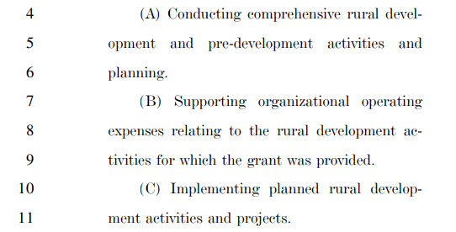




USDA Rural ParTnership Program
BBB House version
      USDA Rural Partnership Program (proposed)
        Rural Prosperity Development Grants - $873 million
        “To provide grants to support rural development”
          Eligible applicants include:
            (I) Units of local government
            (II) Tribal government
            (III) An authority, agency, or instrumentality of an entity described in subclauses I or II

Slide 22
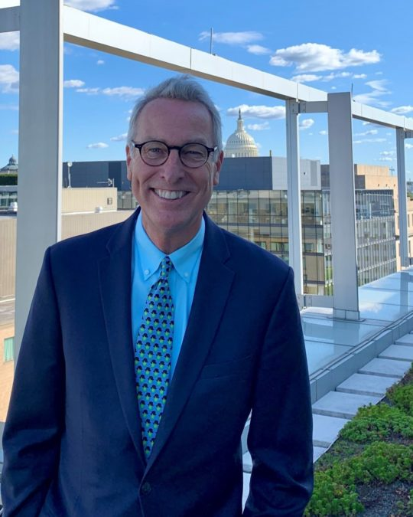
Hal Hiemstra: summit strategies
Webinar recording from NADO and Summit Strategies presentation on the Infrastructure Investment and Jobs Act (IIJA) Bipartisan Infrastructure Bill, featuring Hal Hiemstra, Partner at Summit Strategies, available here
Hal Hiemstra has more than 30 years of experience in government affairs. He represents a wide range of public and private sector clients on issues involving transportation, aviation, appropriations and other federal funding, economic development, infrastructure, community health and safety, and the environment. Hal has worked on every national surface transportation reauthorization since ISTEA (1991). Hal works closely with NADO’s staff to support NADO’s transportation advocacy work.

Slide 23
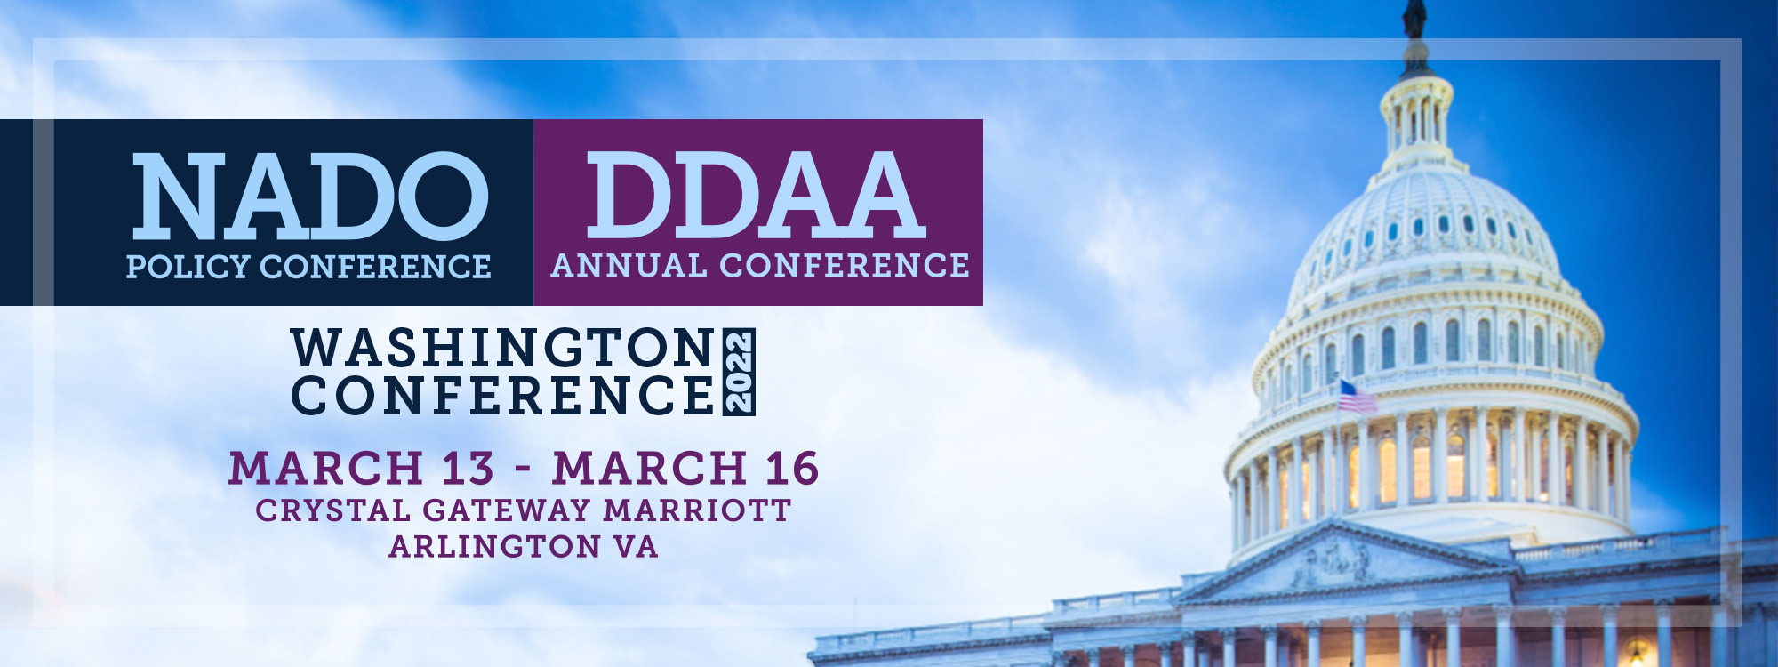
NADO & DDAA Washington conference

Slide 24
Questions?

